Slide 1
Castro Valley Nike Missile Site SF-31C
Preservation & Historical Interpretation
Presentation by Gregory Brown
Nike Missile Veteran and SF-88 Volunteer

Slide 2
Lake Chabot / Castro Valley Nike Missile Site SF-31C
• “SF” designates the San Francisco defense area.
• “C” identifies the Control / Integrated Fire Control area, where the radar and guidance equipment were located.
• SF-31C was active from 1955 to 1974 and was staffed by the California National Guard.
• The San Francisco–Oakland Bay Area contained major military, industrial, transportation, communications, financial and government facilities—making it an important Cold War defense area.
2

Slide 3
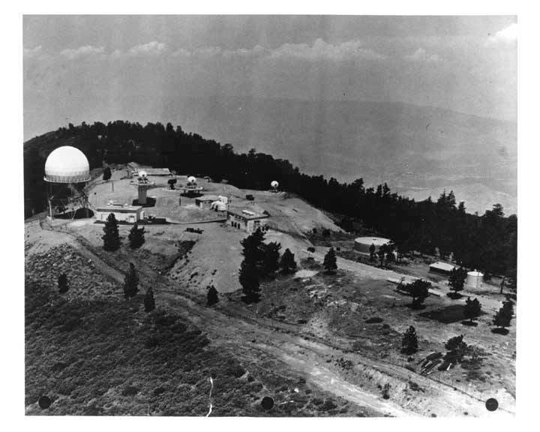
SF-31C — View from the 1960s
3

Slide 4
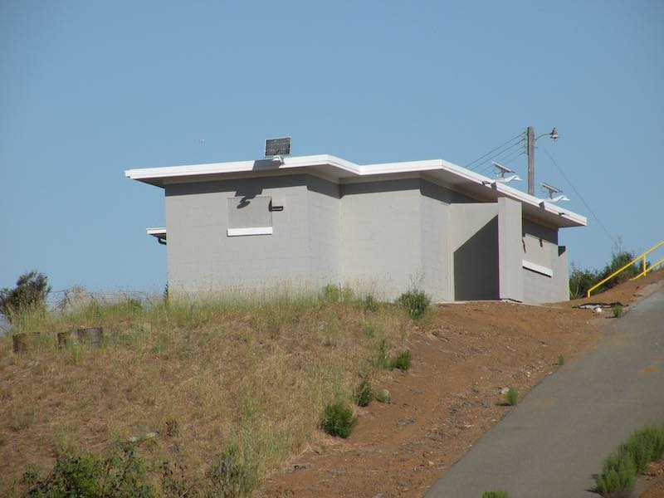
July 2026 — Generator Building
4

Slide 5
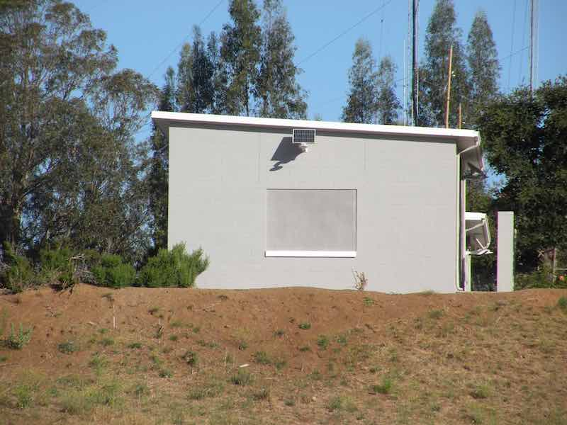
July 2026 — Ready Room
5

Slide 6
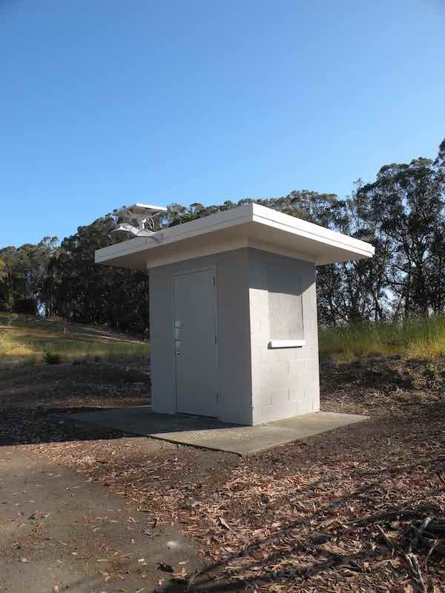
July 2026 — Guard Shack
6

Slide 7
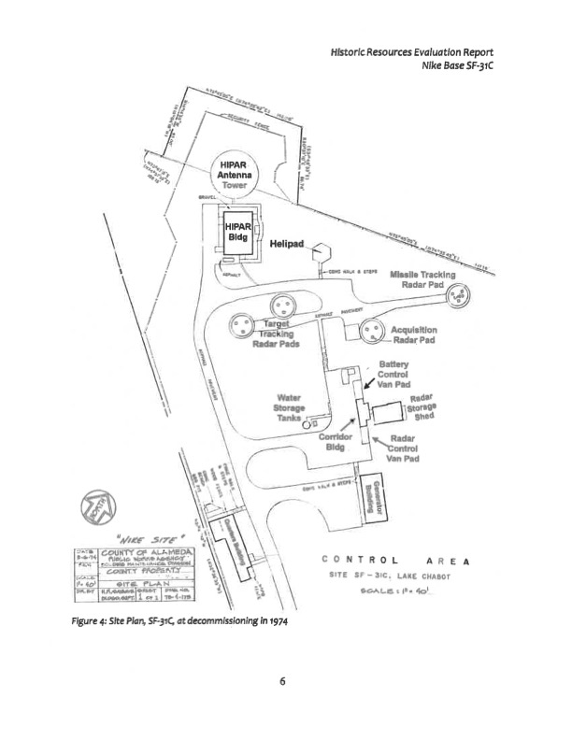
SF-31C Site Plan
7

Slide 8
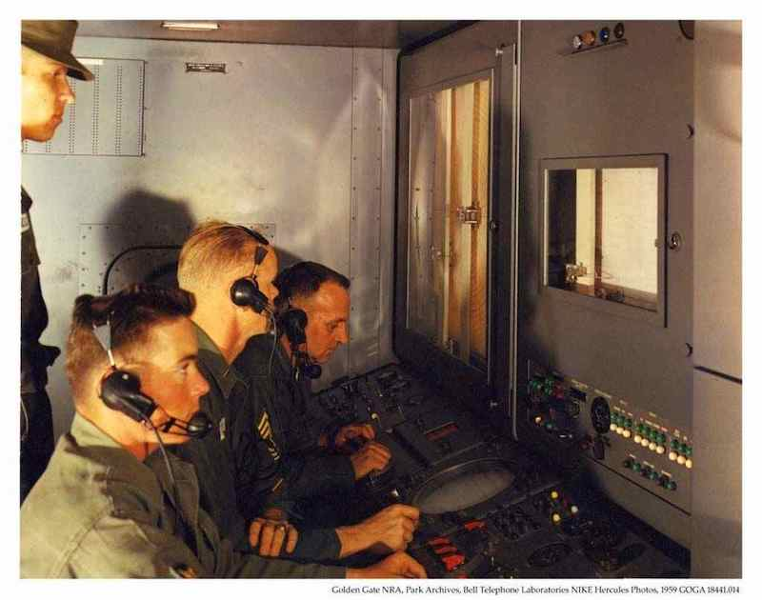
The People Behind the Nike Mission
• A Nike missile site had approximately 120 personnel.
• I was 17 when I arrived at Nike Site LA-88; many crew members were teenagers or young adults.
• My Battery Commander was only 24.
These sites were operated around the clock by young soldiers carrying major Cold War responsibilities.
8

Slide 9
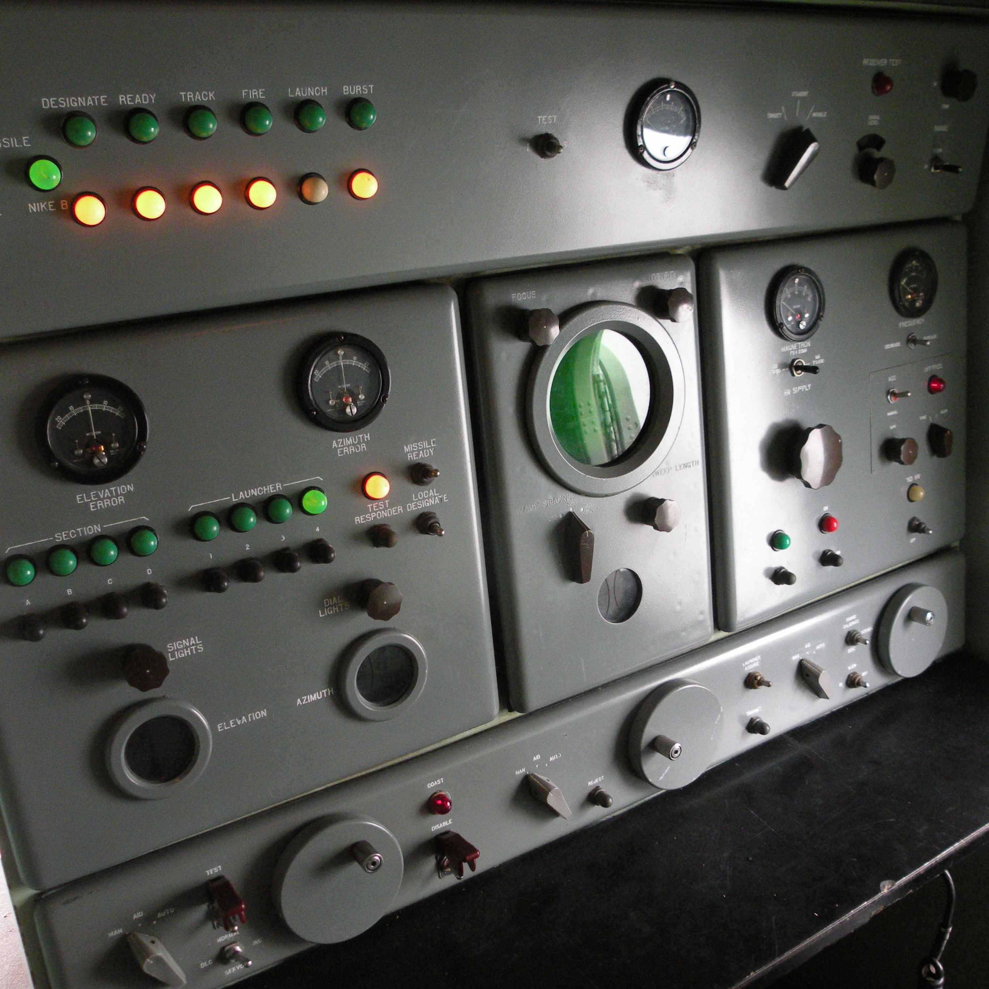
RC Van — Target Tracking
The RC (Radar Control) van contained the equipment used for target tracking.
9

Slide 10
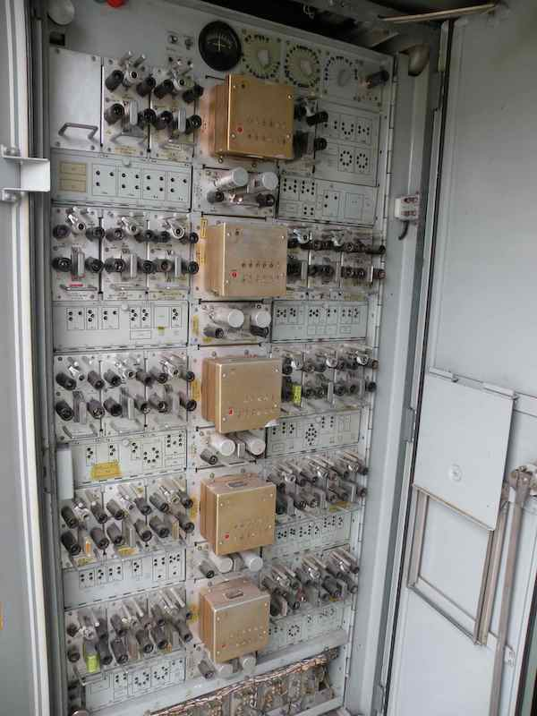
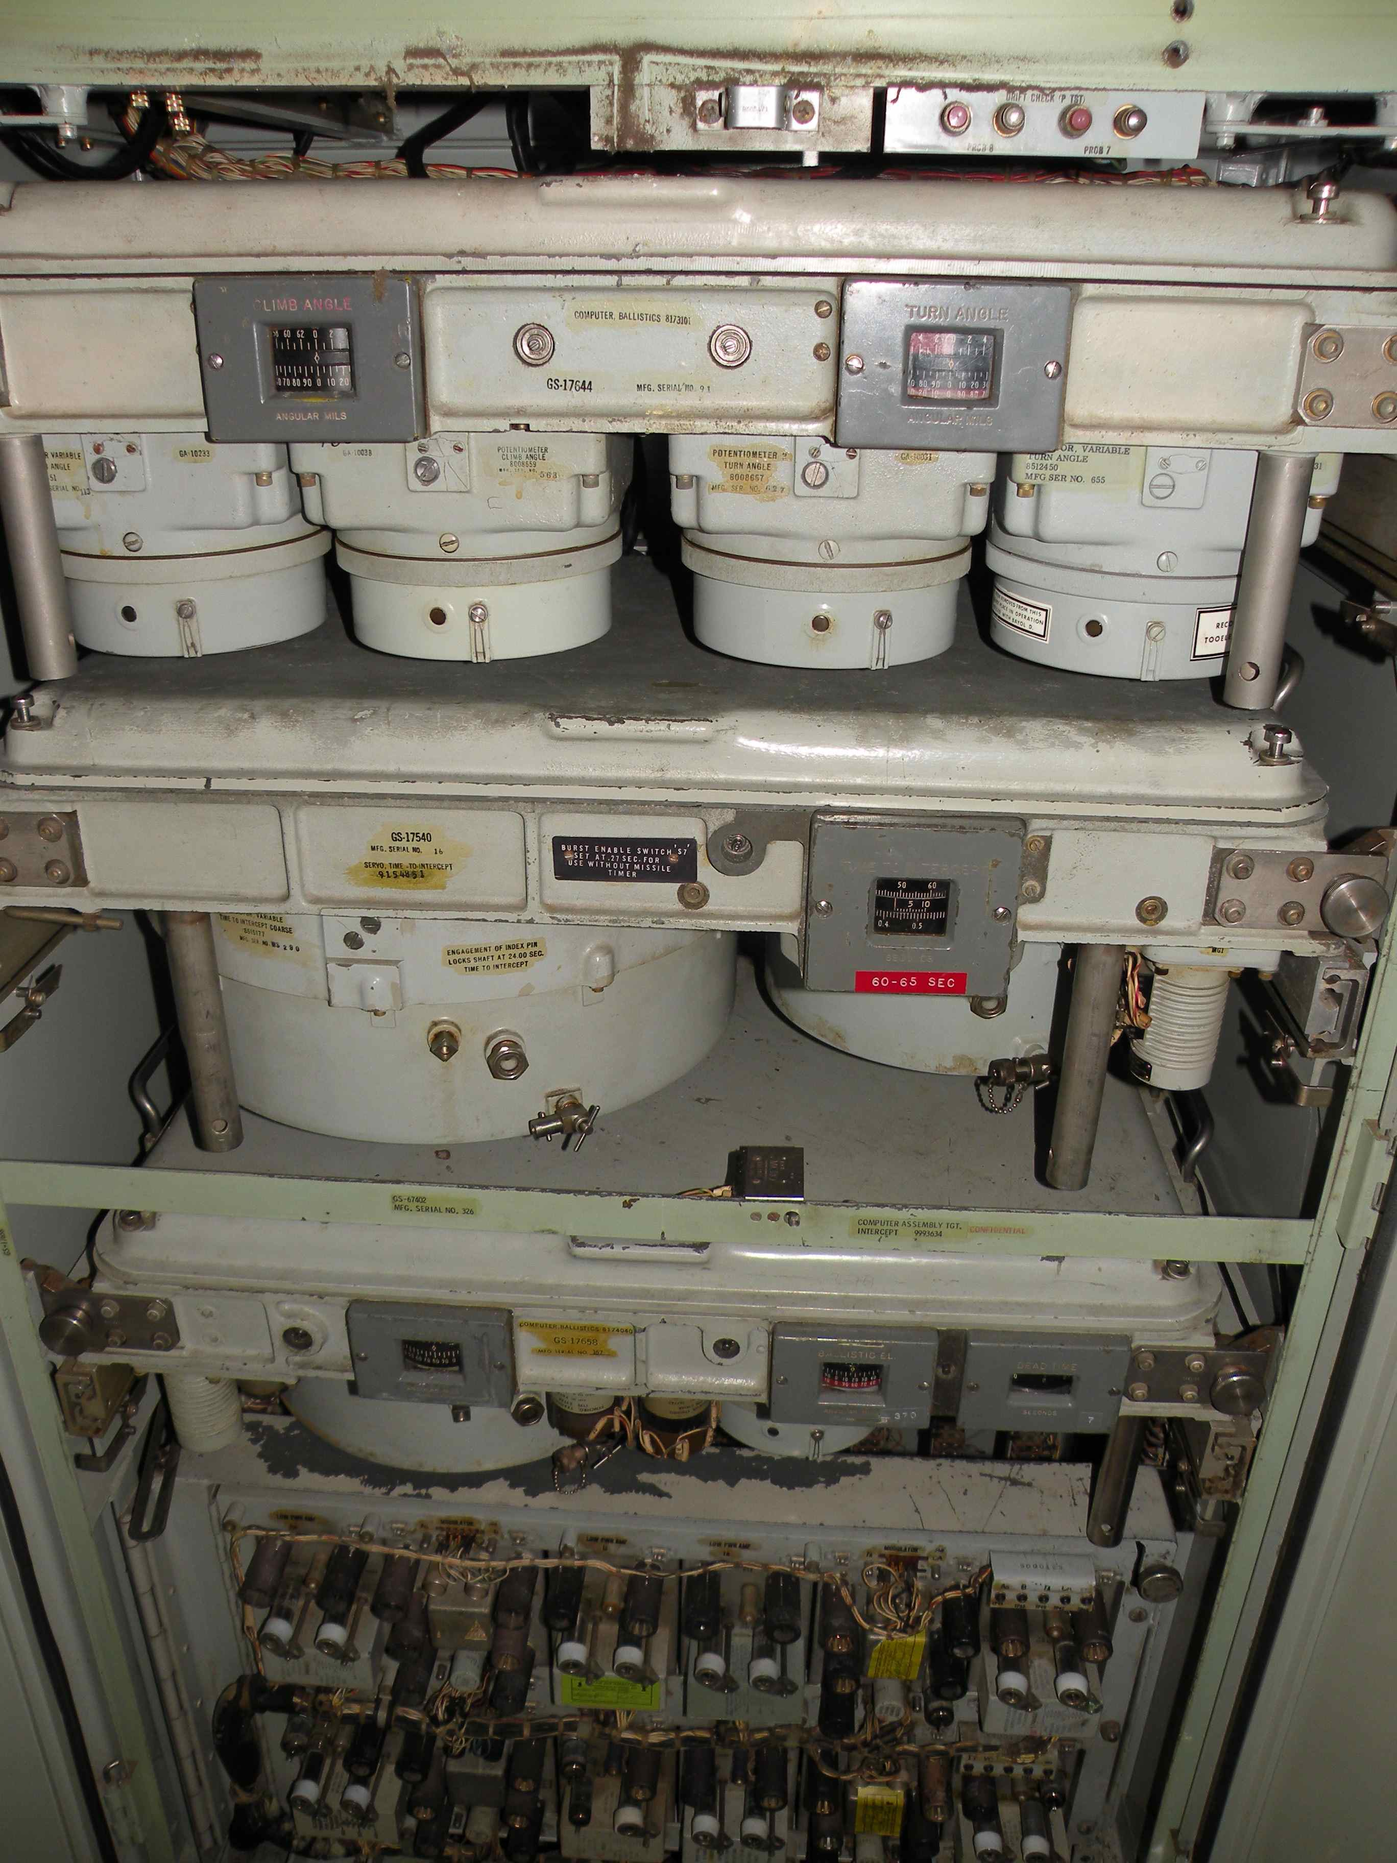
Guidance Computer / Battery Control
10

Slide 11
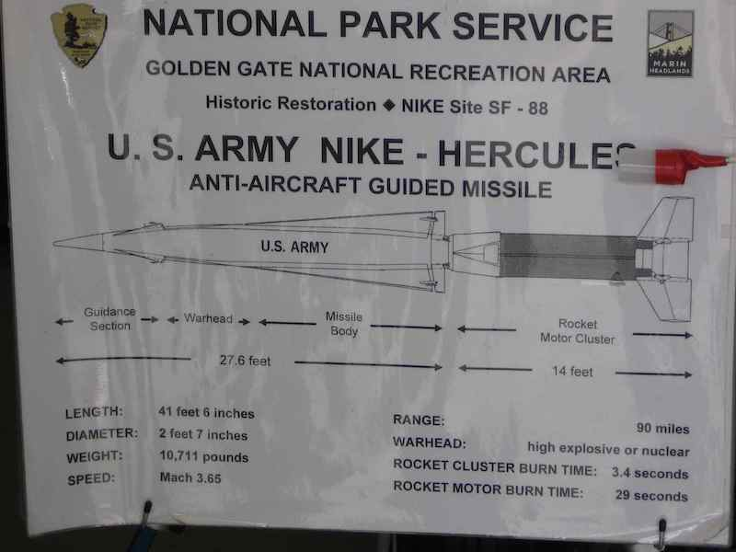
A Practical Interpretation Plan
11

Slide 12
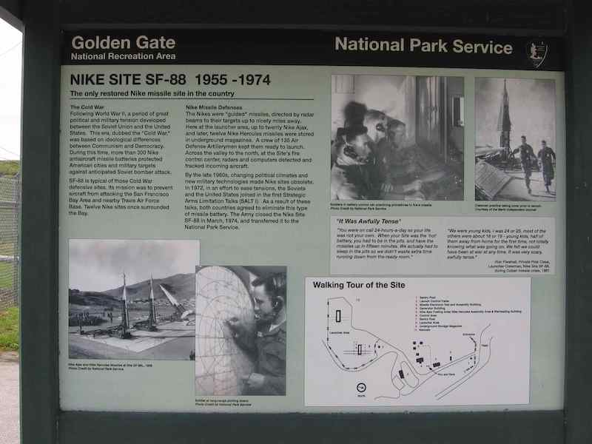
SF-88 — An Example of Nike Site Interpretation
12

Slide 13
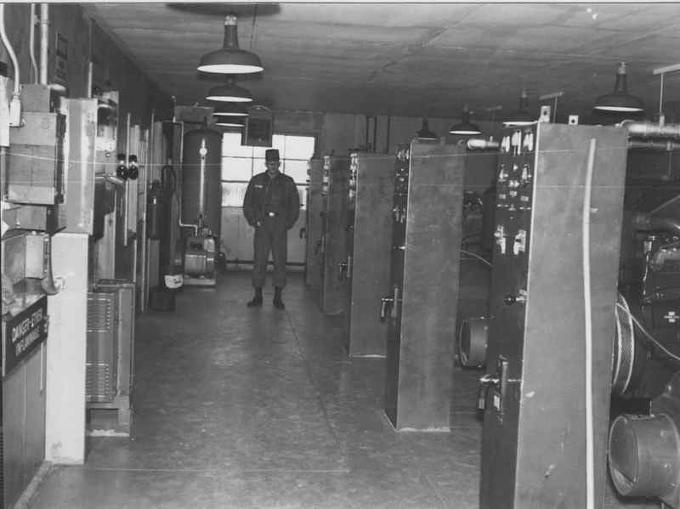
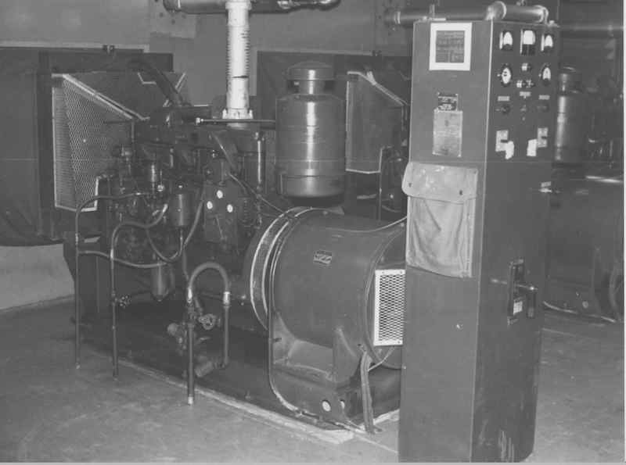
A Picture Story of the Generator Building
13

Slide 14
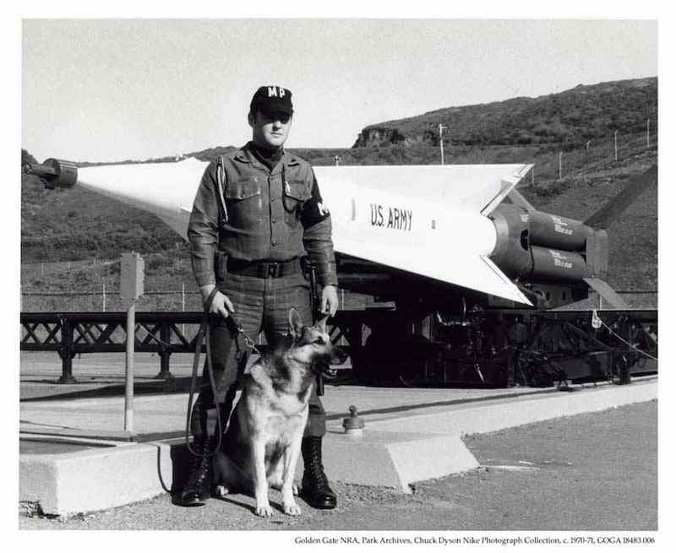
Historic photographs from other Nike sites could help explain equipment, daily operations and the larger San Francisco Bay Area defense story.
14

Slide 15
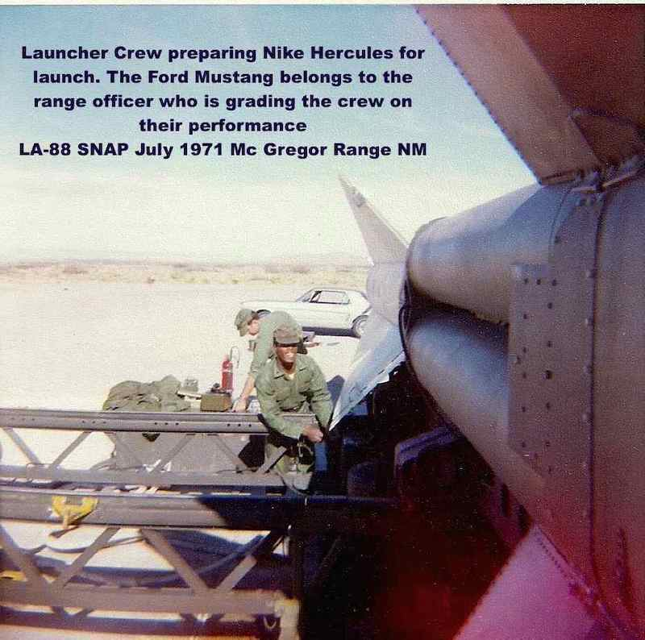
Missiles were not normally fired from operational Nike sites.
Once each year, Nike crews performed live-fire training at White Sands Missile Range in New Mexico.
15

Slide 16
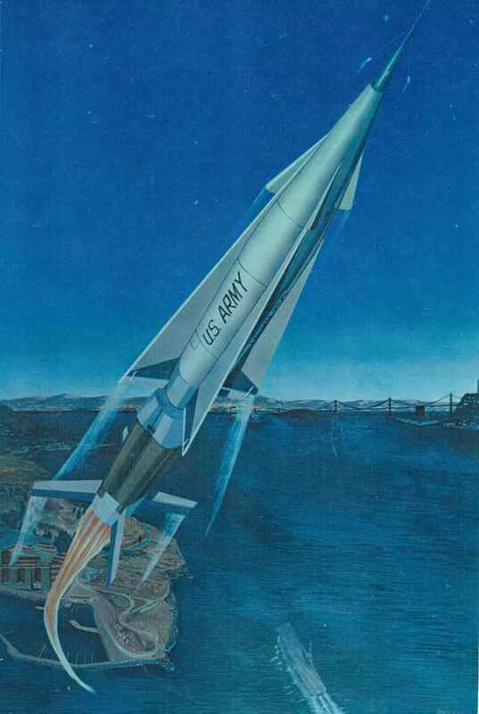
SF-31C Soldiers Supported the Castro Valley Economy
Nike sites contributed to their local communities.
With a reported annual budget of approximately $1.2 million in 1960 dollars, a site supported rental housing, retail purchases and local community participation in civic clubs, churches, Boy Scouts and other organizations.
16

Slide 17
Cold War History as an Educational Resource
At SF-88, the National Park Service used the preserved Nike site to help Bay Area high school students study the Cold War from a local perspective.
A preserved SF-31C could similarly help students explore:
• Cold War history and containment
• Technology and national defense
• The meaning of security in a democratic society
• Alameda County’s place in a larger national story
17

Slide 18
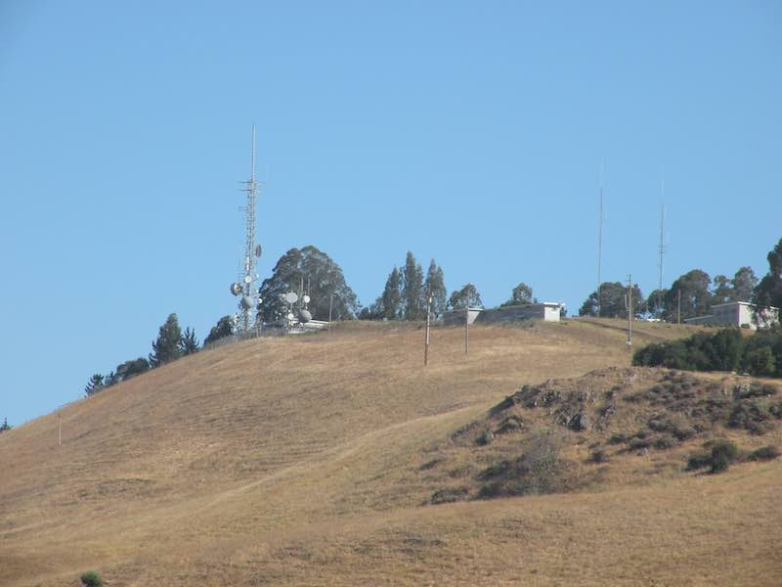
SF-31C Buildings Have a Story to Tell
18

